Slide 1
Typical and atypical reading acquisition and how to support learners who are in need of help
Heikki Lyytinen
Emeritus UNESCO Chair/professor
on Inclusive Literacy Learning for All
& the JLD and reading games teams
Senior Advisor of Niilo Mäki Institute, Finland
University of Jyväskylä, Finland
& Haskins Laboratories, Yale, USA
For publications, see heikki.lyytinen.info and comprehensiongame.info
IARLD, Gainesville, 2023

Slide 2
Important facts about acquisition of the basic reading skills
Reading acquisition = learning to connect items of spoken language to its written forms
Written languages vary in terms of how this connection-building can be made
Alphabetic orthographies such as Finnish, Italian, German, Spanish and African local languages are relatively consistent at grapheme-phoneme level
>no challenges associated with choosing the items which had to be connected from spoken to written
This building of the connections between spoken and written language is very different in English where none of its letters represents the same phoneme in all contexts of written English
Notes:
the deep of orthography are various in different languages. in alphabetic language, the grapheme-phoneme is more consistent in Finnish, German and so on, less consistent in English which may let children take more time to acquire basic reading skills. Thus, we need to take the nature of language into consideration when design teaching and try various methods to help children learn the grapheme-phoneme correspondence rules easily.

Slide 3
The concept of reading skill
Basic reading skills – ability to pronounce written words accurately and fluently – seldom acquired without specific training whose time varies dramatically between writing systems
Literacy – readiness to comprehend fluently written language; requires
  mastery of the spoken language meant to be learned to read
  accurate and fluent basic decoding skills
  a lot of reading to acquire functional reading skill
  leisure reading makes it mostly without specific training
  appropriate strategy, skill and motivation to comprehend the written language
  The final step – acquisition of the full literacy, ability to read with comprehension, ie. learn efficiently by reading eg. schoolbooks
Notes:
although we can naturally acquire the abilities of listening and speaking, becoming a skilled reader is not as easy as. Before we start learning reading in primary school, it is important that we have a rich language environment including reading books with parents and listening materials from different fields to prepare us ready to learn. I think we should spread this idea to parents because some of them may overly dependent on school and do not setting good examples at home.

Slide 4
Reading acquisition and the consistency of the connections between spoken and written
If the reading instruction is organized optimally the time child needs for the acquisition of the basic reading skill is the shorter
  the more consistent the connections are - when only few (if any) complexities/alternatives need to be learned
  the smaller the number of connections one has to learn
Finnish & African. ~40, English >1000, Chinese >3500
In transparent writing the learning burden is about the number of letters + possible complexities such as variations of the lengths of the phonemes mostly presented by repeating the letter (e.g. tuli, tuuli, tulli in Finnish meaning fire, wind and customs)
Notes:
Some aspects of Chinese literacy development do not conform to patterns of literacy development in alphabetic orthographies.
The phonological cues in Chinese is unreliability, so when teaching Chinese reading, we can let children focus on the meanings of character and may tell them how the character evolved to reduce memory load and promote understanding.

Slide 5
Finnish writing system
(based on Latin, as most new orthographies
such as those of Sub-Saharan African local languages)
  21 phonemes/letters(a,d,e,g,h,i,j,k,l,m,n,ng, o,p,r,s,t,u,v,y,ä,ö)
    +”long phonemes”¹
  a Swedish letter (å) occurring in our 2.official language
  6 phonemes/letters (b,c,f,q,x,z) used in the loan words only
  one 2-letter grapheme (+ng for /ŋ:/)
  bidirectionally 100% consistent G-P correspondences =
  storing about 30 correspondences enough for sounding any word
  after inventing the assembly of these sounds =>reading
  no serous complications in sounding or assembling...
  simple syllable structure; few (>3) consonant clusters
  Loan words (+spellings) are adapted into Finnish
    eg. bank → pankki, tractor → traktori, pizza → pitsa
¹ all but /d/,/g/,/h/, /j/, /v/ phonemes can have a long form via repeating the letter
Notes:
The disassembly of Finnish writing system indicates that Finnish is quite simple and transparent, comparing with English then.

Slide 6
English – morphophonemic
  eg. past tense ending marked with -ed, despite different pronunciations
  historical spellings and pronunciations of loan words often preserved
    Chant, chiffo deb） (debitus [lat.])
  over 40 phonemes, 130-500 graphemes
  lots of multiletter graphemes (e.g. ch, sh, ea)
  irregular correspondences in both directions
  P → G /i:/ :
  machine, me, fee）, sea
  , field）, conceiv, key）, quay） ,
  people, subpoena, Caesar ）
  G → P ea :
  great, bean）, head, learn
  bear, hear, heart）
  Complex syllable structure; many consonant clusters
Notes:
Unlike Finnish, English is quite complex and non-transparent.

Slide 7
Pseudoword reading accuracy, grades 1-4
Aro & Wimmer, 2003
100
80
Percent correct
60
40
20
0
1st
2nd
3rd
4th
1st
2nd
3rd
4th
1st
2nd
3rd
4th
1st
2nd
3rd
4th
1st
2nd
3rd
4th
1st
2nd
3rd
4th
1st
2nd
3rd
4th
English
Dutch
German
French
Spanish
Swedish
Finnish
Language and grade level
Notes:
Pseudoword reading accuracy could reveal the grapheme-phoneme correspondence in languages.
The higher percent correct of pseudoword reading means the more consistent G-P correspondences in the language.
The table indicates that English student do worse in pseudoword reading than the others. Nearly grade 4 in English can catch up with grade 1 or 2 in Finnish and other languages.
Students reading French do the best, but this may not due to the simpleness of French. Instead, the advanced education in France may play a more important role.

Slide 8
Development of Nonword Reading accuracy during 1st Grade in European orthographies
(Scottish data up to 2nd grade)
正确率
COST A8 results, 1998
Notes:
During the first year of learning language, Finnish learners do best in nonword reading.
This indicates that Finnish has the most consistent G-P correspondences and the orthographie is the simplest.

Slide 9
The development of reading accuracy (% correct) during the 1. Grade in Finland
36
100
36
100
27
75
80
27
60
18
50
18
Procentage of correct items
Procentage of correct itmes
Number items from 36 orrect
Onumber items from 36 correct
40
9
25
9
20
0
0
0
0
School entry
+10 vk.
1.Gr ends
School entry
+10 vk.
1.Gr ends
+5 week
+15 week
+5 week
+15 week
The average development
Individual development
Aro et al., 2004
Notes:
The figures clearly indicate the reading accuracy development in Finland.
For individual development, it might be a good idea to put an average level of development in the figure and highlight it. Thus not only could we easily figure out the individual difference but also the characteristic of a person’s development by comparing his line with the average one.

Slide 10
Compromised reading skills (% of population)
Biological reasons
                Global > 5%
        Finland > 3% (and other transparent languages)
Educational reasons
                Global - up to 90% (in developing countries)
                Finland – 0%
            >600 million compromised readers
            Many times more fail to become fully literate?
                statistics tend to tell only the portions of children in a country who fail to acquire basic reading skills
Notes:
Here we attach great importance to education which plays a significant role in the reading acquisition.
It might be a good idea to put the two kinds of reasons a little bit further. For example, what is the detailed information about the educational environment in Finland? Why is it so good in education? And what does the biological reasons mean exactly?
Of course, it is okay to put it in a narrative way instead of putting it into the ppt.

Slide 11
    Dyslexia (as it is defined today in most English based descriptions)
    – developmental difficulty compromising the acquisition of accurate and fluent reading and spelling skill of one’s native language independent of adequate reading instruction
    belongs to a continuum of language disorders
    difficulties in single word decoding, usually reflecting insufficient phonological abilities (Lyon, 1995)
    phonological core difficulty?
    Phonological processing & awareness, pseudoword repetition, naming fluency, verbal short-term memory
    Highly heritable - genetic differences affect the opportunity to benefit from environmental language input?
What if I write my definition as follows?
Dyslexia is mostly a teaching problem if we include the most
effective digital teaching tools to be available to teachers everywhere.
These tools such as the GraphoGame can open all bottlenecks making reading acquisition difficult independent of the reason why these do so!
Also reading comprehension should be included in potential difficulties.
Everyone can be helped to comprehend written language as well as one comprehends the same given orally by using such new tools
Notes:
It might be a good idea to mark that the definition and relevant information are about the Phonetic language rather than Chinese.

Slide 12

The Jyväskylä Longitudinal study of Dyslexia (JLD):
An intensive follow-up of children at familial risk for dyslexia from birth to adulthood
Early identification of children who need help due to dyslexia
&
Graphogame & ComprehensionGame – our tools to help via prevention of RDs
> JLD 1994-
Researchers:Timo Ahonen, Mikko Aro, Kenneth Eklund, Jane Erskine, Tomi Guttorm, Leena Holopainen, Jarmo Hämäläinen, Ritva Ketonen, Marja-Leena Laakso, Seija Leinonen, Paavo Leppänen, Matti Leiwo, Marja-Kristiina Lerkkanen, Kaisa Lohvansuu, Paula Lyytinen, Kurt Muller, Anna-Maija Poikkeus, Anne Puolakanaho, Ulla Richardson, Paula Salmi, Asko Tolvanen, Minna Torppa, Helena Viholainen
> Graphogame (Ekapeli, EP) in Finland, 2004-), the Finnish participants
Ekapeli/Graphogame (ks.www.lukimat.fi; grapholearn.info):
Researchers: Mikko Aro, Jane Erskine, Jarkko Hautala, Riikka Heikkilä, Sini Hintikka (Huemer), Ritva Ketonen, Janne Kujala, Juha-Matti Latvala, Lea Niemelä, Marko Niemelä, Emma Ojanen, Mikko Pitkänen, Suzanne Puhakka, Miia Ronimus, Nina Saine, Paula Salmi, Vesa Rantanen, Ulla Richardson
Programmers: Iivo Kapanen, Ville Mönkkönen, Miika Pekkarinen
> ComprehensionGame (from 2022- see comprehensiongame.info)
Definition of the demand characteristics; and research: Heikki Lyytinen
Programming: Kristian Jeskanen, Panu Nummelin & Pyry Lappalainen
Content creation: a large number of students of different disciplines of University of Jyväskylä, Finland
JLD&EP Supporters EU, Niilo Mäki Institute, Academy of Finland, Univ. of Jyväskylä, Tekes, RAY, Ministries of Education&Foreign Affairs Finland, Kela, Finnish Cultural Funds, Nokia Oy, Kone Oy, Wärtsilä Oy.
Notes:
I am interested in the program in Africa, since your participants are mostly European. The idea to transfer this Finish grapho game to an African version because they share the characteristic of high transparency is amazing.

Slide 13
The goals of the JLD which has followed children with familial risk for dyslexia from birth to adulthood
observing precursors of dyslexia (”behavioral causes” of dyslexia)
predicting (developmental correlates of) compromised acquisition
defining developmental paths anticipating steps of learning to read
identifying as early as possible children needing help in reading ac.
The last step: developing preventive measures helping chidren in
  a) overcoming difficulties related to learning to decode
  b) supporting readinesses to learn by reading e.g. schoolbooks
Notes:
It is important to note that precursors and predictors of dyslexia is not general. We’d better build our own model in our own language. Also, some of the precursors and predictors are worth paying attention to in familiar risk children but not in normal children. So to identify dyslexia risk family is important(in China)

Slide 14
The mean skill profiles of subgroups the parents with dyslexia of the to-be-followed children
）
z-score scale (mean=0, sd=1
of the normally reading control parents)
-4,5
-4
-3,5
-3
-2,5
-2
-1,5
-1
-0,5
0
Reading pseudo- & nonwords
）
Piglatin
Auditory short-term memory
Lexical decision speed
Orthographic reading
Lexical decision accuracy
Segmentation
Naming, serial
Phonological deficit
Naming, singular
Orthographic deficit
Spelling errors
Orthographic-semantic deficit
Reading errors
Multiple deficits
Reading speed
Segmentation deficit
Notes:
It is important to note that although these parents are divided into several subgroups due to their different kinds of deficit, they all have a bad performance overall(below 0). The difference is the degree to which they differ from each other.

Slide 15
Heterogeneity of profiles associated with the index parents with dyslexia
The dyslexic parents who are inaccurate and/or slow readers show still substantial between-individual variation of skills - five dissimilar cognitive profiles:
  Phonological – poor pseudoword reading
  Orthographic – slow word recognition
  Orthographic-semantic – slow/inaccurate lexical decision
  Multiple – several poorly developed skill domains
  Segmentation – inability to “hyphenate” words
  Verbal auditory memory > compensated readers
    Not used as an inclusion criterion
：
Notes:
This slide introduces what exactly parents’ deficits are. As seen from the 14th PPT slide, the parents with dyslexia are divided into five groups according to their deficit types (phonological, orthographic, orthographic-semantic, multiple, segmentation), and their scores from different tasks vary considerably, which also implies a further research on the possible impact of parents’ deficit types on the probability of dyslexia.

Slide 16
SCREENING OF THE FAMILIES
Number of children who have attended the last originally agreed assessment phase in Grade 3
Born at the hospitals of Central Finland during
01.04.93-31.07.96
N= 9368 infants
I Screening
II Screening
III Screening
Short questionnaire administered at the maternity clinics
N=8427 parents
Compre-hensive
questionnaire
N=3146 parents
AT-RISK GROUP
N=117
infants
AT-RISK GROUP
N=108
children
Assessment of parents’ reading and spelling skills
N=410
parents
CONTROL GROUP
N=105
infants
CONTROL GROUP
N=92
children
Notes:
This slide presents the screening process of the participant families. The screening is started with distributing questionnaire at the maternity clinics, those parents who filled in with their address would receive a further comprehensive questionnaire, and parents who reported reading difficulties of themselves or their close relatives would be invited for an assessment of reading and spelling skills, making up the final sample (i.e 117 infants in at-risk group, 105 infants in control group) in JLD. The participant attrition rate is remarkably low in the long-term follow-up study, which implies high parental cooperation.

Slide 17
PHASES OF ASSESSMENTS
Neo-
natal
6 month
14 month
18 month
2
years
2½ years
3½ years
4½ years
5
years
5½ years
6½ years
AT-RISK GROUP
N=108
children
N
=
107
N
=
112
N
=
108
N
=
108
N
=
107
N
=
107
N
=
107
N
=
107
N
=
107
N
=
107
N
=
107
CONTROL GROUP
N=92
children
N
=
96
N
=
94
N
=
94
N
=
95
N
=
96
N
=
94
N
=
95
N
=
93
N
=
93
N
=
93
N
=
93
Data gathering continues
Primary school
Secondary school
Adulthood
I
grade
II
grade
III
grade
VII
grade
VIII
grade
IX
grade
20 years
N
=
107
N
=
108
N
=
108
N
=
85
N
=
101
N
=
88
N
=
27
AT-RISK GROUP
School entry at the age of 7 years
N
=
92
N
=
92
N
=
92
N
=
66
N
=
81
N
=
76
N
=
16
CONTROL GROUP
CLASSMATES
N = 1549
N = 1756
N = 2641
N = 1452
N = 1705
N = 204
Notes:
The assessments start from newborn to adulthood, and the exact assessing ages are listed above. It’s noted that every participant child is assessed individually according to his or her age, which indicates an individual calendar profile being recorded by researchers for every child. Also for this reason the data gathering of 20 years old adulthood is carrying on.

Slide 18
CRITERIA FOR DYSLEXIA
A child was considered to have dyslexia in Grade 8, if she / he scored below the 10th percentile of Control group’s performance in reading speed in at least two out of the three following tasks:
  Word list reading
  Text reading
  Pseudo word text reading
：
Altogether 185 children from the original sample (200) were reached in Grade 8. They were classified into four groups according to the criteria as follows:
  At-risk with dyslexia, N = 33
  At-risk with NO dyslexia, N = 68
  Controls with NO dyslexia, N = 77
  Controls with dyslexia, N = 7 (not included in the following analyses)
Notes:
This page introduces the criteria of dyslexia in this experiment.
I think the reason why the researchers choose “10th percentile of the control group’s performance” (rather than risk group’s or all samples’ average) is that control group’s language ability is closer to (and used as a reliable sample of) majority, and at-risk group’s performance score is too special to be the criteria, meanwhile the quantity of potential-dyslexic children is biased in this study so that the overall average score cannot stand for the average score of 8th-graders.

Slide 19
The reading status of children born at familial risk for dyslexia at school age
Expectation when one parent with dyslexia:
  > 1/2 of the children affected
The observed result: 42 / 108
  compromised initial reading acquisition 38 / 108;
  in 2.gr. >4x and in 8 gr. 3x compared to controls
  persistent reading problems 42 / 101
Notes:
We can find that risk group has more dyslexia children than control group throughout the recording period, from which we can assume that family environment and genes have strong impact on reading ability.

Slide 20
Children with reading disability
1st gr
2nd gr
3rd gr
8th gr
At risk group
N = 38
N = 38
N = 36
N = 42/
101
N=108
1st gr
2nd gr
3rd gr
8th gr
Control group
N = 10
N = 9
N = 10
N = 14
/81
N=92
Notes:
As grade level rises, the number of children with reading disability in risk group is always more than in control group, but in 8th grade, the gap narrows(is there a significant change?).
Question:
Thus can we assume that this is because reading becomes more difficult in higher grades so that some of the control group students couldn’t perform well?
Are there dyslexic children in one assessment phase overlap another in both group, if so, how many are they? (e.g. in at-risk group, 38 detected in 1st grade and 38 in 2nd grade, how many children detected as dyslexia are the same and how many are “newly dyslexia”)

Slide 21
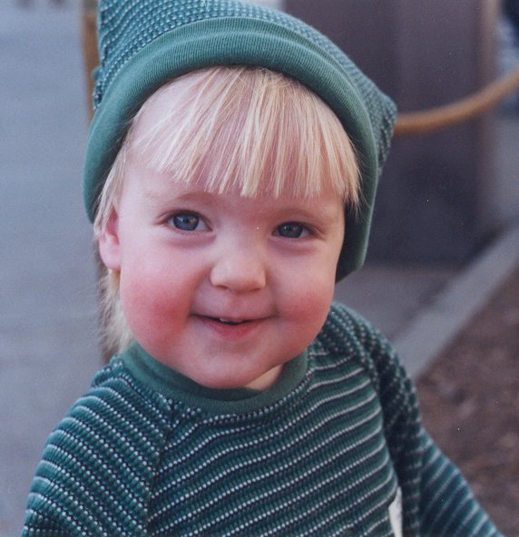
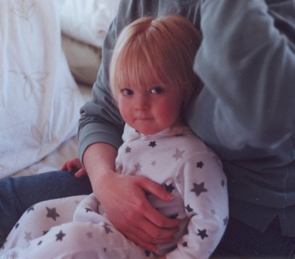
SPEECH PERCEPTION, COMPREHENSION,PRODUCTION
Auditory discrimination
Phonological processing
Vocalization
Vocabulary, Morphology, Syntactic skills
征
CHILD’S CHARACTERISTICS
Attention
Psychophysiological
Temperament
力
心的
气质
INTERVENTION
Phonological
Naming
Family School
NEUROPSYCHO-
LOGICAL FUNCTIONS
Visuo-spatial skills
Articulation, Motor Skills
COGNITION
IQ, Memory
Associative learning
ASSESSMENT
DOMAINS
家
HOME ENVIRONMENT
Parent-child interaction
Print exposure
Parenting, Stress
成就
ACHIEVEMENT
Alphabetic skills
Reading & Spelling
Math skills
Notes:
This slide shows several assement domains and the specific list within each assement domain that used to measure the children.
There are so many aspects to be concerned and assessed in this study –assessments include levels from neurophysiology, cognition, to overall environment; domains of child and parents; phase from description, detection, explanation, and intervention. I feel pretty amazing about the whole design of this study. Thank you for your sharing!

Slide 22
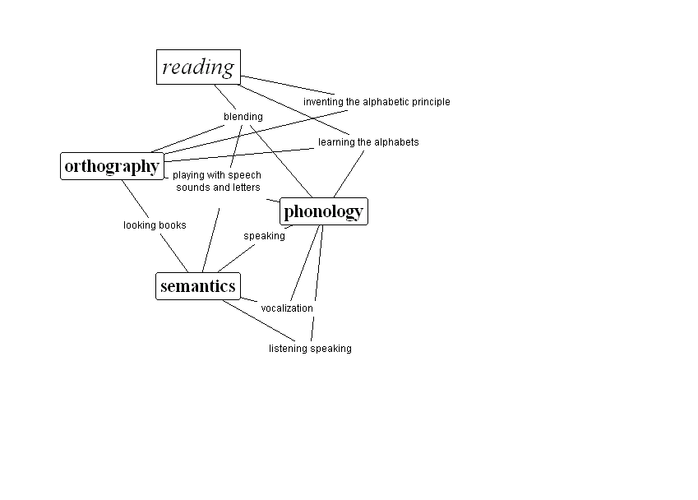
IDENTIFYING & PREDICTING RISK
significant predictors found in the follow-up from birth of children at familial risk for dyslexia (JLD)
P = Predictors
D = Differences between groups
Age Variable
7 - yrs Reading accuracy & speed D
5 - yrs Naming speed P & D
4 - 6 yrs Phonological manipulation P & D
5 - 6 yrs Letter knowledge P & D
5 - yrs Verbal memory P & D
3 - 6 yrs Phonological sensitivity P & D
3 - 5 yrs Inflectional skills P & D
2 - 3 yrs Articulation accuracy P
2 yrs Maximum sentence length P & D
6 mth Speech perception P & D
3-5 days ERP to speech sound P & D
3-5 days ERP to pitch differences with/without reading disorder
Lyytinen et al., Annals of Dyslexia, 2004; Dyslexia, 2004; Sage Handbook of Dyslexia, 2008
Notes:
After analyzed the result of assessments,as shown in the right panel of the slide, the researchers found that some assessments could be used as predictors and some showed a difference between the two groups.
The most amazing result went to the 3-5 days ERP measurements. They found that when the baby was only a fews days old, babies of the at-risk group already ‘responded’ different as compared to the control group babies. On the other hand, we could find out the potential at-risk babies by using ERP measurement, thus early intervention for them would be possible .
Question: It seems that it is a really good result that many predictors were found. But I am curious about how this result affects the actual prediction work of dyslexia? Can we utilize them in practice and make prediction based on this? What’s more, this result is derived from Finnish language, which means that the feature(e.g. orthography) can be language specific. It is possible that in different language(e.g. Chinese), the predictions differs.

Slide 23
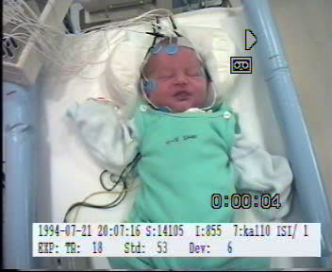
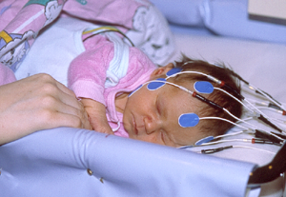
Newborn ERPs to tone frequency change differ between 2nd grade typical control and dyslexic at-risk readers
MMN-paradigm
Standard
Deviant
Dev 1100Hz, 12 %, SOA 425 ms
Std 1000Hz
EOGL
EOGR
-
EOGL
-
EOGR
-
-
3µV
-
3µV
+
+
+
100ms
+
100ms
PCA components
100ms
F3
F4
F3
F3
F4
F4
1 2 3
C3
C4
C3
C3
C4
C4
P3
P4
P3
P3
P4
P4
At-risk dyslexic readers
(RDFR, N=8)
Control typical readers
(TRC, N=25)
Leppänen et al, 2010, Cortex
Quiet sleep
Notes:
The reaserchers played sequential discrete audio stimulus consisting of several standard stimulus and 12% deviant stimulus to the babies, and record their brain responses using ERP measurements.
And after the babies were grown up to 2nd grade children, they compared the ERP datas of the control typical readers and the at-risk dyslexic readers.
And the result,as shown in the slide,reveals that control typical readers could tell the difference between the standard stimili and the deviant stimili, but the at-risk dyslexic children failed. This means those who have dyslexia can be diagnosed when they were only few days old using ERP measurements.
Question: Does control typical readers mean those kids who were in control gourp and without dyslexia when they were 2nd grade? And At-risk dyslexic readers means those who were in at-risk group and with dyslexia when they were 2nd grade? I am not that clear about this part. Thank you sincerely!

Slide 24
ERP measurement for newborns
Notes:
With the ERP measurement, we are able to reach a further understanding of the genetic basis of dyslexia.

Slide 25
Milestones of the early development of skills preparing child towards the basic speaking skill during first 50 weeks of
life in the at risk and
control groups.
50
L
40
i
f
e
30
Weeks of life
w
e
e
20
k
s
10
At-risk group
Control group
0
1
2
3
4
5
6
7
8
9
10
11
1. Vocalizations which resemble sounds
2. Sustained vocalization
3. Cooing-like vocalization
4. Sustained vocalization with pauses
5. Two kinds of vocalizations
6. Imitates parents’ vocalization
7. Initiates redublicated babbling
8. Combines two different syllables
9. Uses gestures
10. Parallel pointing and vocalization when wants something
11. Uses word-like expressions
Vocalization
Notes:
The parents of the at-risk group and control group were asked to record their babies’vocalization performance during the first 50 weeks after the babies were born. Then the researchers analyzed the videotape and portrayed the developmental curves of 11 minestones that prepared the children for the later basic speaking skills.
The chart in the slide showed the result. And we can learn that for the first 9 milestones, there were no significant developmental time difference between the two groups. Only the last two milestones-parallel pointing and vocalization when wants something, and uses word-like expressions –suggested a delay in at-risk group compared with control group.
Therefore, it seems that during the first 50 weeks of life, the at-risk babies showed tiny delay of the development of early language skills. Thus, these milestones failed to be considered as possible predictors of the dyslexia children.
Question: Although ERP measurements showed the implic potential of the at-risk babies, but it seems that they didn’t show explicit vocalization deficit from this slide. And it seems that they don’t have problem in using oral lauguanges when they grow up. So why does their difficulty in distinguishing the sound of the syllables greatly block their way to reading but not talking?
Something else I would like to say：Thank you for your kindness and patience. This was such an amazing project that greatly inspired me!!! Before I came to the class, I was sometimes upset about some great but‘useless’ papers and wondering if I could do something turelly meaningful for my country or even for the whole world as a psychologist. After learning your project from the class, now I’m very proud to be a psychology student and confident to make the world a better place in a psychological way.

Slide 26
60
50
L
50
L
40
i
i
f
40
f
e
e
30
w
w
e
30
e
e
e
20
k
k
s
20
s
At-risk group
10
At-risk group
10
Control group
Control group
0
0
1
2
3
4
5
6
7
8
9
10
11
12
1
2
3
4
5
6
7
8
9
10
11
12
13
14
15
1. Raises head
1. Both fists tightly clenched
2. Turns head towards parents
2. Palmar grasp: holds finger tightly
3. Rolls from stomach to back
3. Holds fists open or slightly clenched
4. Rolls from back to stomach
4. Reaches with a half-open hand
5. Crawls: stomach in contact with floor
5. Plays with hands
6. Sits alone by taking support with hands
6. Brings toy to mouth
7. Sits alone without suppor
7. Reaches for an object to touch
8. Raises self into a sitting position
8. Grasps an offered object
9. Crawls on hands and knees
9. Transfers an object from hand to hand
10. Pulls to stand by furniture
10. Holds two objects at same time
11. Moves around by holding onto furnitur
11. Beginning thumb-forefinger grasp
12. Walks alone 10-15 steps
12. Drops an object intentionally
13. Pincer grasp: straight forefinger & thumb
14. Bangs two objects together
15. Advanced pincer grasp: bends fingers
Gross Motor
Fine Motor
Notes:
From the two pictures, we can see children in at-risk group and control group have similar gross motor and fine motor, which indicates at-risk group and control group don’t have significant difference in motor.

Slide 27
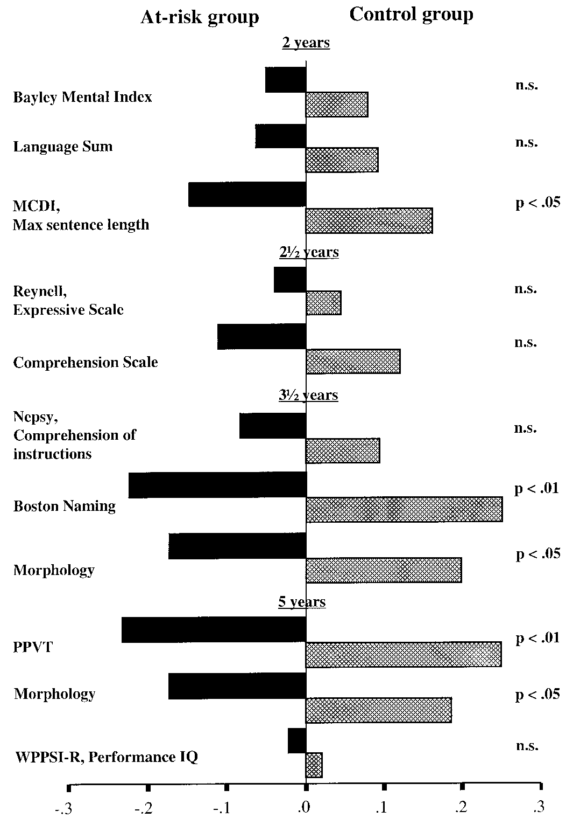
2 vuotta
Risk group
2.5 vuotta
Control group
3.5 vuotta
Scale:
Z-score based on the mean and SD of the control group.
Group differences still significant after controlling IQ
5 vuotta
Notes:
Before going to school, the children from risk group perform worse in naming and morphology when compared with control group. From this graph, can we think that problems in auditory may occur earlier than visual problems? Because the morphology maybe represent the visual problems.

Slide 28
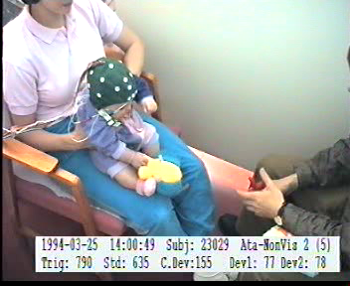

Slide 29
At 6 months of age babies of the control group show differential response to the infrequent deviants among /ata/ vs. /atta/ sounds but children of the at risk group fail to do so
(Leppänen & Lyytinen, 1997; Leppänen et al. 2002).
Notes:
This is the ERP evidence of the importance of phonemic length in Finnish.
It shows that the auditory attribute may be important in reading. But in Chinese, we don’t have the length of the phoneme, so the tone may be important in Chinese reading. And from some Chinese dyslexia, I find that some of them can’t distinguish the tone. So maybe the ERP between the Chinese risk group and control group can be different.

Slide 30
Is reading acquisition associated with early language delays?
Late talking – delay in the development of expressive language skills (assessed here at 2 years of age)
  Similar numbers of children in both groups could be defined as late talkers
  Do children with normal speaking at 2.5 years age differ from those who start speaking later (after 2.5 y of age) in their later language development?
    If so how?？
  Is late talking connected to reading acquisition
    If so how?
Notes:
I think that they have differences. Because if the children can’t speak with others early, he( she ) will contact less stimulation than others, so their various skills related to language development will be affected in the future. For reading comprehension is no exception.
Doubt : why there are similar numbers of children in both groups could be defined as late talkers?

Slide 31
Development of language skills among late talkers of the risk and control groups
1.0
At-risk
Controls
0.5
Z-score
composite of language skills
0
-0.5
-1.0
-1.5
2
3 1/2
5
2
3 1/2
5
Late talkers
Age (years)
Late talkers
Not late talkers
Not late talkers
Lyytinen P. et al., J. of Speech, Language & Hearing Res;2001
Notes:
For the children of the at-risk group, with the growth of age, late speaking children’s comprehensive ability aren’t change although there is a rise when 3.5y. But for the children of the control group, with the growth of age, late speaking children's comprehensive ability will be slow to catch up the at-risk group. Speaking late is not an absolute criterion for judging whether a child is dyslexia.
Doubt : so why there are children who have late speaking problem in the control group?

Slide 32
The development of the expressive and receptive speech among late lalkers in the control and at risk groups
Receptive speech
Expressive speech
0.5
0
The mean of
the standard
scores of
several related
Measures
-0.5
-1.0
-1.5
-2.0
2.5
3.5
5.5
2.5
3.5
5.5
Years
Age of the assessment
At-risk– speech comprehension and it’s reception , N=12
At-risk – speech , N=10
Control– speech comprehension and it’s reception N=3
Control – speech N=10
Notes:
If a child has problems in speech, then his speech comprehension and it’s reception can achieve to a normal level. On the contrary, if a child has problems in speech comprehension and it’s reception, so the level in his speech will be very low too. The results show that the speech comprehension is a high risk factor. Besides, childrens’ speech can be Trained and promot with the growth of age.
Doubt : why the mean of the standard score of the receptive speech in at-risk-speech group are higher than the control- speech comprehension and it’s reception?

Slide 33
Criteria for dyslexia
A the end of 2. grade eight measures were taken
  four measures representing reading/writing accuracy
  four measures representing reading fluency
A score exactly at the 10th percentile of the control group’s performance or below was classified as fulfilling the criterion of poor performance in that task
A child was diagnosed as dyslexic/poor reader if she/he
  fulfilled the criteria on at least three out of four measures in reading/writing accuracy
  OR
  on at least three out of four measures in reading fluency
  OR
  fulfilled the criteria on two measures, both in accuracy AND in the fluency domain.
Notes:
I think the time of test and criteria were presented explicitly here. Wha’s more, we can know from the criteria that both reading/writing accuracy and reading fluency are very important in reading, and deficit in either of them is enough to make a children dyslexic. And one should fulfill the criteria on at least three out of four measures in reading/writing accuracy or reading fluency to meet the criteria for dyslexia.

Slide 34
Reading skill at the end of the 1.Grade in the different subgroups of early
language development (late expressive or both the expressive and receptive language )
）
1,5
Controls with typical
start of speaking
Composite
score of reading accuracy and
fluency measures
1
At risk children with typical start of speaking
Controls with late talking
0,5
0
-0,5
Controls with late
express.&recept. speech
-1
-1,5
At risk children with late
Talking
r
-2.0
At risk children with late
expressi.&recept. Speech
Typical development of
early speech Control Risk group
Controls
At risk group
Delayed express+receptive speech
Lyytinen, Eklund & Lyytinen, 2005
Notes:
As we can see from this diagram, the effect of gene is significant. At risk children even the ones with typical start of speaking still had lower scores than children with late express and reception in control group. Besides, the scores of control groups with express or reception delay was lower than that with typical start of speaking, which implied that the behavior factors are also important when predicting children’s language development.
I also have a question that why the scores of at risk children with typical start of speaking is higher than at risk children with late talking? Is it statistically significant?

Slide 35
Spelling skills by groups at the end of the first grade
Remainder of the control group
1,5
Remainder of the at-risk group
1
Late talkers1 control group (expressive delayed) ）
0,5
Mean z-score
Composite
0
Late talkers2 control group (receptive and expressive delayed)）
-0,5
-1
Late talkers1 at-risk group (expressive delayed) ）
-1,5
Late talkers2 at-risk group (receptive and
expressive delayed)）
-2.0
Remainders of the groups
Control group
At-risk group
Late-talking groups
Lyytinen, P. Eklund & Lyytinen, Annals of Dyslexia, 2005
Notes:
Again, the effect of gene is shown. The z-score of late talkers at risk group with reception and express delay was the lowest. What’s more the scores of remainder of the at-risk group was even lower than late talkers in control group. So I think may be we should pay more attention to children at risk when they are still young.
Besides, there is something that I found interesting. The z-score of late talkers in control groups with reception and express delay was the highest. May be this consistent with a Chinese old saying that the late talkers are smarter. That’s amazing!

Slide 36
PISA READING PERFORMANCE (age: 15 y) of children with typical language development and subgroups of late talker
Lyytinen, et al. 2015 Current Developmental Disorders Reports, 2, 4, 330-338.
Notes:
PISA( Programme for International Student Assessment) is a kind of international assessment which held every three years, composed of reading, mathematic and science tests.
We are happy to see that the z-score of children at risk with no language delay was above zero, however, their z-score was still lower than control groups with delay in expressive language, which made us worry again. As we can see from the diagram, the z-score of children at risk with delay in expressive and receptive language was lower than that of children with only expressive delay. This may mean that several risk factors put together would make the problem more serious.
In addition, the children with delay here had already accepted intervention. Unfortunately, we can see that the the effect of intervention is not so efficient.

Slide 37
DEVELOPMENT OF LETTER KNOWLEDGE
）
Letter names known
Age ( years)
年龄（岁）
Notes:
This research used the number of known letter names to represent the letter knowledge level. In Finnish, letter names are approximately the same as sounds of letter accounting for the transparence and the pronunciations of letter names are longer and more explicit than that of letter sounds. In the contrast, most of the African languages use English letter names while has an African sound in letters, which is one reason why African children have difficulties in reading acquisition. From the figure we can see that all of the children developed the letter knowledge whether they are from at-risk/no risk family and whether they had difficulties in reading. But there also resists significant difference between control group and the group of at-risk with dyslexia, for the latter develops slower than normal ones from 4.5 to 5.5 years old and the letter names they have already know are always less than the control group have at the same age. This is accounted for letter knowledge is an important component in the development of reading skills.
On the other hand, although there are people who have difficulties with reading in their family, the group of at-risk while having not dyslexia perform better than dyslexia children and worse than controls, which reminds us that there is genetic influences on reading of children with no dyslexia but from at-risk family and we can not ignore that. Fortunately, the influence is not that significant. However, when there is one family or there are families showing dyslexia, we should focus on the descendants such as sparing more effort on teaching them to read, in order to avoid block in reading when they grow up.

Slide 38
The JLD-follow-up from birth to school age of reading-related development
Receptive speech, 2.5 y.
Pseudoword repetition, 3.5 y.
Phonological skills, 3.5 y.
Phonological skills, 4.5 y.
Phonological skills, 5.5 y.
Rapid naming, 5.5 y.
Rapid naming, 6.5 y.
Letter knowledge, 3.5 y.
Letter knowledge, 4.5 y.
Letter knowledge, 5 y.
Letter knowledge 5.5 y.
IQ, 5 y.
Lyytinen, et al.
Scand. J. of
Psychology,
2009.
Reading composite, 1. gr.
Reading composite 2. gr.
-3
-2
-1
0
1
z-score (mean = 0, sd =1)
Individual profiles of the prediction measures of the JLD children whose reading acquisition was most severely compromised
Notes:
Each broken line represents one child’s individual profile in reading. It is obvious that the compromised reading acquisitions are accounted for various reasons for the lines are so messy. However, there are still some rules we can follow. For example, letter knowledge of most children are below standard level from measures of 4.5 years old which suggests that low letter knowledge is exceptionally predictive indicating children with dyslexia more consistently than any other predictors and this can inspire us to create measuring tools for teachers and parents easy to test their students or children so that we can identify children who are in real need of preventive practice in time. (Lyytinen, et al., 2009)This is just the principle that Graphogame depends on. It is noted that letter knowledge is not the complete predictor of reading acquisition, i.e., other instructions like phonemic-based instructions can suffice in overcoming the risk showing by low letter knowledge.(Puolakanaho et al., 2007)

Slide 39
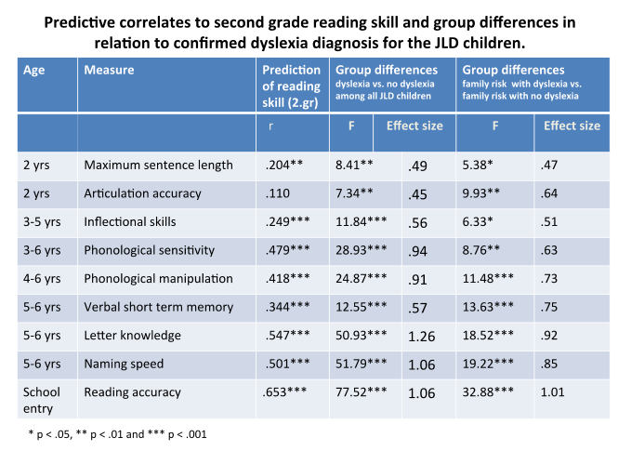
Lyytinen et al., in press
Notes:
As we can see from this diagram, letter knowledge and reading accuracy were the most efficient predict factors, because the effect size of both of them were close to 1. This meant that letter knowledge and reading accuracy are very important when diagnoses whether a child is dyslexia or not.
However, I have a question. Is it enough that just test reading accuracy when the kids prepared going to school?Should we also need to test the reading speed? Or is reading speed not important for them since most of them still can not read fluent when entering school?

Slide 40
Predicting reading fluency
.55
Reading accuracy
1st to 3rd Grade
7 to 9 years
Letter knowledge
4.5 to 6.6 years
.81
Phonological awareness
1st Grade, 7.5 years
.24
.52
.52
Reading fluency
8th Grade, 15 years
Rapid Naming
5 to 6.5 years
.27
CFI= 0.98 TLI=0.98
RMSEA=.043, SRMR=.036
chi= 112.063 (df=82), p=.004
N=200
R²=49.5%
Notes:
As we can see, children used more and more mature strategy to read fluently, and they considered the whole massage when they were older than 6.5 years. In addition, letter knowledge was very important in developing phonological awareness. Besides, it was efficient when predicting reading accuracy as well.
So, I think maybe we should focus more on letter knowledge when children are at the age of 4.5 to 6.6. That time may be something like critical period.

Slide 41
Observing developmental routes to dyslexia
Predictive domains, assessment ages from 1-6.5 y Alpha*
  Receptive lang. 12,14,18mo, 2.5, 3.5, 5.0 y .78
  Expressive lang.12,14,18 mo,2.0, 2.5, 3.5, 5.5 y .93
  Morphology 2.5, 3.5, 5.0 y .76
  Verbal short term memory 3.5, 5.0, 5.5, 6,5 y .75
  Rapid serial naming 3.5, 5.5, 6.5 y .89
  Letter knowledge 3.5, 4.5,5.0, 6.5 y .72
  Phonological skills 3.5, 4.5, 5.5, 6.5 y .82
  IQ 5.0
Outcome measures used as a composite of the following measures:
Reading accuracy (Aug.,Jan.,May), Fluency (Aug.,Dec.,April,May/1 gr, Nov/2.gr), Spelling (Dec., Apr,/1.gr Nov/2.gr) and Comprehension (Apr./1gr. And Nov/2.gr)
Lyytinen et al., Merrill-Palmer Quarterly, 2006
Notes:
the knowledge of morphology can predict the higher-level of phonological awareness, which is prequist for accuracy.
Due to the length of many Finnish words, the fluency and verbal short term memory is necessary for reading passages

Slide 42
Profiling of the subgroups of the reading related developmental differences
Method: Latent profile analysis – variances set as
equal between groups
Program: MPLUS (including imputing the missing data)
Estimation method: Maximum likelhood parameters estimates with robust standard error
Criterion: Bayesian information criterion
N=199
）

Slide 43
Profiles of early cognitive skills for different subgroups across ages 1 to 6.5 years, their average performance in reading and writing composite score across Grade 1 and 2, and PISA reading composite at 15 years of age. (Modified from Figure 1 in Lyytinen et al., Merrill-Palmer Quarterly, 2006)
Notes:
the declining trajectory subgroup showed decrease in most skill domains across time.
Children from typical trajectory developed gerenal skills gradually.
Children in dysfluent trajetory had naming speeding problems, which is unique among all subgroups.
the language skill of members from unexpected trajectory group were firstly good, but declined later.

Slide 44
）

Slide 45
The role of IQ
None of the compromised readers had
  < 85 in both verbal and performance IQ assessed using WISC-R.
None of the compromised readers had
  < 85 in mental or motor domain at 2.5 years assessed using Bayley Scales of Infant Development
。
Notes:
That means IQ is not a significant predictor of dyslexia, because none of the compromised readers’ IQ below one standard deviation compared to average contemporary.
——Cathy (Zixi. Cheng）

Slide 46
Precursors/predictors: conclusions
Familial background increases the risk of dyslexia substantially – relatively the more so, the more severe reading difficulties are attended。
Speech perception is predictive from 6 months and does so at school age still after controlling for other known predictors
Very early language delays can be informative, both in the expressive and receptive language domains but receptive language may be more important
Poor letter name learning predicts without false negatives (false positives should be accepted
Dysfluent naming predicts the most persistent difficulties
Notes:
Children’s reading interest did not directly predict any of the skills in our although itwas associated with the amount of shared reading, which in turnwas associated with vocabulary development. In the at-risk group, however, an interestingly with vocabulary development. In the at-risk group, however, an interestingly strong path was discovered between 3.5-years vocabulary and reading interest strong path was discovered between 3.5-years vocabulary and reading interest level (at 4 to 6 years of age). Even though the strength of this association in the at-risk group is partly caused by a few children with very low vocabulary scores
and also a very low reading interest level, removal of the data on these children did not erase the association.

Slide 47
Lyytinen & Ahonen, 1989)
Notes:
The genetic factors of parents are important predictor of the child.
Children’s language skills have evocative effect on parent-child communication.
Family language environment affect children’s language skills by parent-child environment.
Poor language skills of child or/and parent may cause reading avoidance, consequently leads to selection of environments, then so called “Matthew effects” happen in the end.
Parents’ attitude towards reading has significant effect on children’s reading action.

Slide 48
Reading game and research environment for the acquisition of the basic reading skills:
Graphogame helps by applying the dynamic assessment in storing connections between spoken and written language and trains thus children to acquire the basic reading skills by using the basic form of learning, association learning which, however, is not sufficient for reaching the main goal of reading
= mediation the meaning of the text which is needed for efficient learning from school books

Slide 49
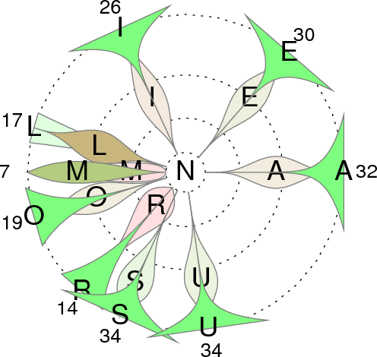


Graphogame – an enjoyable mobile or computer game for learning to read: How it helps at risk children to overcome the fuzziness of the phonemic representations with letters
Competitor’s result
Falling letters下
0
Player’s results游戏玩家的结果
9
A
U
E
Correctly chosen letter
Mouse pointer
Player’s catcher
Competitor’ 对手的
Description. In the game (left) the learner is choosing (in its classical version) from the falling balls the corresponding letter of the one s/he hears from headphones. The illustration (right ) shows an example of how results can be followed. Here we follow how /N/ sound (in the centre) which learner has heard in the game more than 100 trials at the moment this picture is printed from the game logs has made him/her to choose incorrect alternative letters (shown with the number of times these have occurred with the correct N-letter). The red distributions reveal that the learner has had difficulties in not to choose R and M during the first fourth of such trials, but became able to learn during the last fourth (with green distribution) that e.g.R does not represent the /N/ sound. For this learner acquiring that the /N/ sound is not represented by M-letter has been a real challenge as shown by the red and darker green distributions which reveal that most of the choices during the first and second fourths of trials (respectively) have ended up to this mistake. The learner has failed to learn to identify the correspondence of the /N/ sound during the whole session in trials where M has occurred (7 times) as an alternative. On the other hand s/he has not chosen e.g. S to represent the /N/ sound any more during the last fourth of the trials (no misidentifications during the 9 last of the 34 trials with S as an alternative). For more details, see Lyytinen et al., Scand.J.Psychol., 2009, 50, 668-675 and for documentation of the efficiency of the game in supporting learning among at risk children, see eg. Saine et.al., Child Development , 82,3,1013-1028.
.
Notes:
Graphogame provides an interesting and attractive way to help at risk children to discriminate and identify the phonemic representation with letters.
The game builds a platform for an individual to compare their progress with others’ by competition.
The diagram demonstrates with different colour and data the degree of a player’s mastering each letter and the progress he or she has made during the whole session. It also illustrates the frequency of mistakes and the phase they occur.
The most powerful function it has accomplished is the logged data for each child and adapted presentation of alternative letter based on one’s unique pattern of mistake, which can give a more specific and evidence-based instruction and intervention for experts if the children needs more help.

Slide 50
Description
In the game (left) the learner is choosing (in its classical version) from the falling balls the corresponding letter of the one s/he hears from headphones.
The illustration (right ) shows an example of how results can be followed.
Here we follow how /N/ sound (in the centre) which learner has heard in the game more than 100 trials at the moment this picture is printed from the game logs has made him/her to choose incorrect alternative letters (shown with the number of times these have occurred with the correct N-letter).
The red distributions reveal that the learner has had difficulties in not to choose R and M during the first fourth of such trials, but became able to learn during the last fourth (with green distribution) that e.g.R does not represent the /N/ sound.。.

Slide 51
For this learner acquiring that the /N/ sound is not represented by M-letter has been a real challenge as shown by the red and darker green distributions which reveal that most of the choices during the first and second fourths of trials (respectively) have ended up to this mistake.
The learner has failed to learn to identify the correspondence of the /N/ sound during the whole session in trials where M has occurred (7 times) as an alternative.
On the other hand s/he has not chosen e.g. S to represent the /N/ sound any more during the last fourth of the trials (no misidentifications during the 9 last of the 34 trials with S as an alternative).
。
For more details, see Lyytinen et al., Scand.J.Psychol., 2009, 50, 668-675 and for documentation of the efficiency of the game in supporting learning among at risk children, see eg. Saine et.al., Child Development , 82,3,1013-1028.

Slide 52
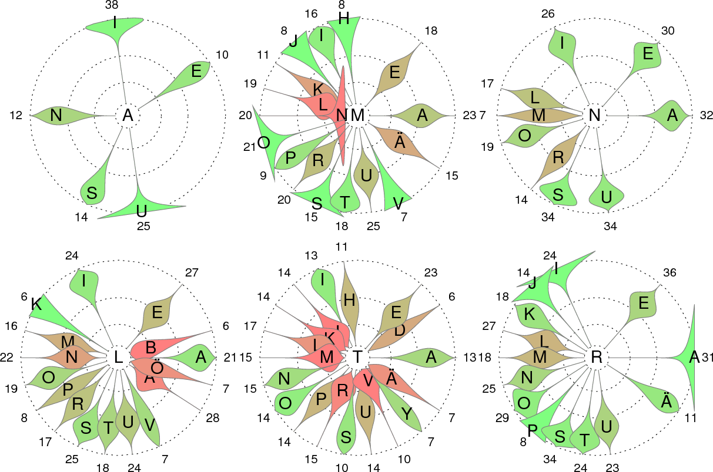
..continuation of the feedback about learning of different letter-sound connections Illustration of the game developed by Janne Kujala

Slide 53
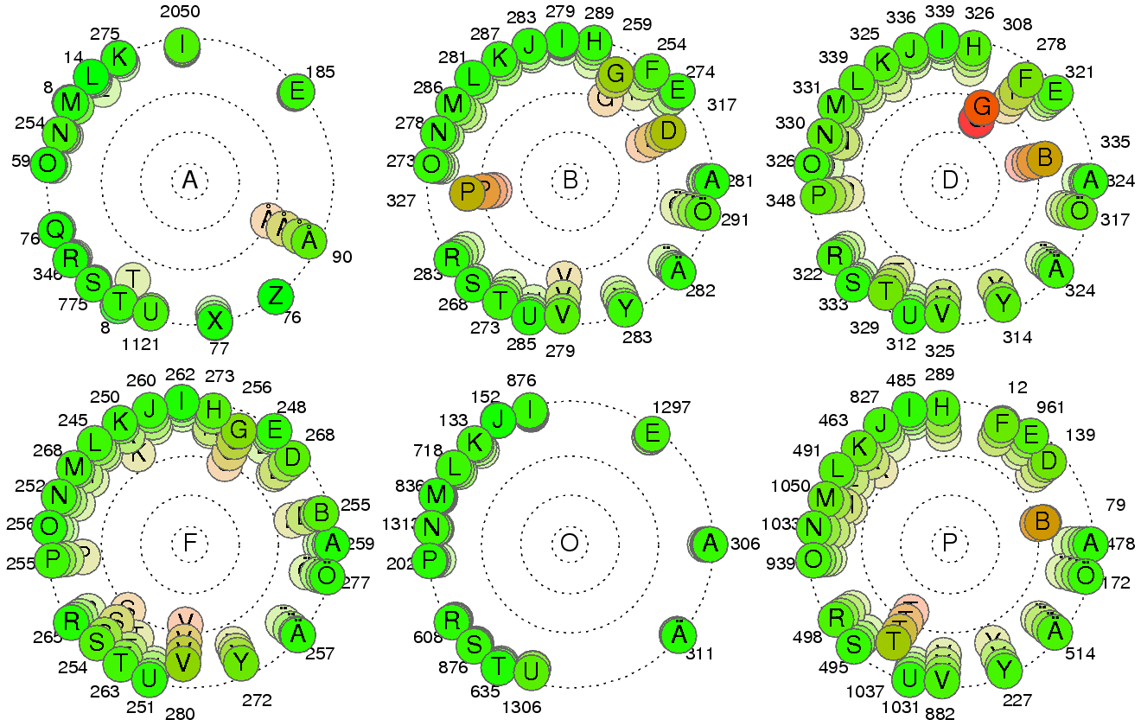
.. continuation.. Computed to illustrate the actual status of the whole classroom of learners Illustration of the game developed by Janne Kujala
Notes:
The numbers in each figure indicate the number of occurrences of the letter. Green represents a low error rate, and red represents a high error rate. Each graph contains a lot of information, I will explain one by one. The upper left corner of the figure shows the letter A is easy to distinguish, with little or no error. The figure in the middle of the first line shows that children would easily confuse B with P, V, D, G. The figure in the right of the first line shows that children would easily confuse D with B and G, especially G. The figure in the left of the second line shows that children would easily confuse F with P,V,G,S and T. The figure in the middle of the second line shows that children would easily distinguish O. The figure in the right of the second line shows that children would easily confuse P with B and T.

Slide 54
Graphogame as an assessment tool
Dynamic assessment:
  Online follow-up of the results of learning connections between spoken and written items
  Immediate application of the observed results to guiding the training to bottleneck areas
  i.e. integrating assessment and intervention as made in the response-to-intervention model with the exception that the cycle of refocussing intervention can happen in seconds
：
Notes:
Graphogame is an Dynamic assessment tool. When the child is playing Graphogame, all of the real-time data from the software will be used to adjust the intervention. This means that the training which children received will change based on their performance at the time, if they perform good, the difficulty of the training will increase, on the other hand, the difficulty of the training will reduce.

Slide 55
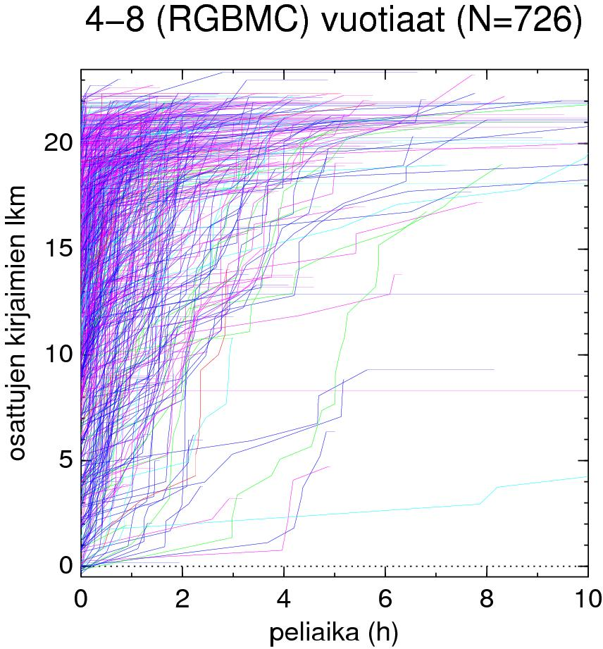
Exemplary learning curves of children at risk showing the time needed for learning the sounds of the letters among Finnish children (N=726) using the Finnish version of the GraphoGame (=Ekapeli)
。
The cumulative
number of the
acquired connections between sounds and letters
Hours of playing
Modelling: Janne Kujala
Notes:
This picture shows a lot of learning curve of the children who have risk suffering from Dyslexia in Finnish. Most children can associate most of the letters with the correct sound after 2 hours of playing. Although there are few children can not associate 10 of the letters with correct after 10 hours of playing. And when we use the Graphogame ,we shouldn’t make the children to play the game for a long time, so we'd better keep the time around 15 minutes.

Slide 56
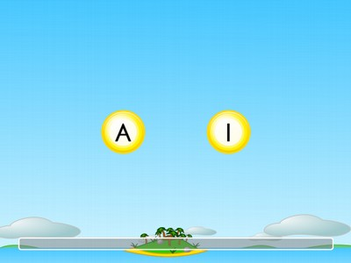
Training pre-schoolers at risk
3 hours of training of 6.5 year old kindergarten children at risk (in short ~10 mins sessions):
--- Graphogame (GG) training group: matching speech sounds with letters Graphgame
  --- Control group: GG calculation exercises
Comparison and follow up of:
  --- Pre-reading skills
MMN responses for vowel and vowel duration change
Notes:
I think it is important to train children at risk in short ~10 mins sessions because it can promise children’motivation.
The study suggests that preschool children might benefit from a targeted sound–letter matching intervention and indicates
that some of the reading related problems might be alleviated even before the school start. But I think if the study could have larger samples and different subgroups of children will make the benefit result more profoundly.
See ：Reading skill and neural processing accuracy improvement after a 3-hour intervention in preschoolers with difficulties in reading-related skills for more information. doi:10.1016/j.brainres.2012.01.071

Slide 57
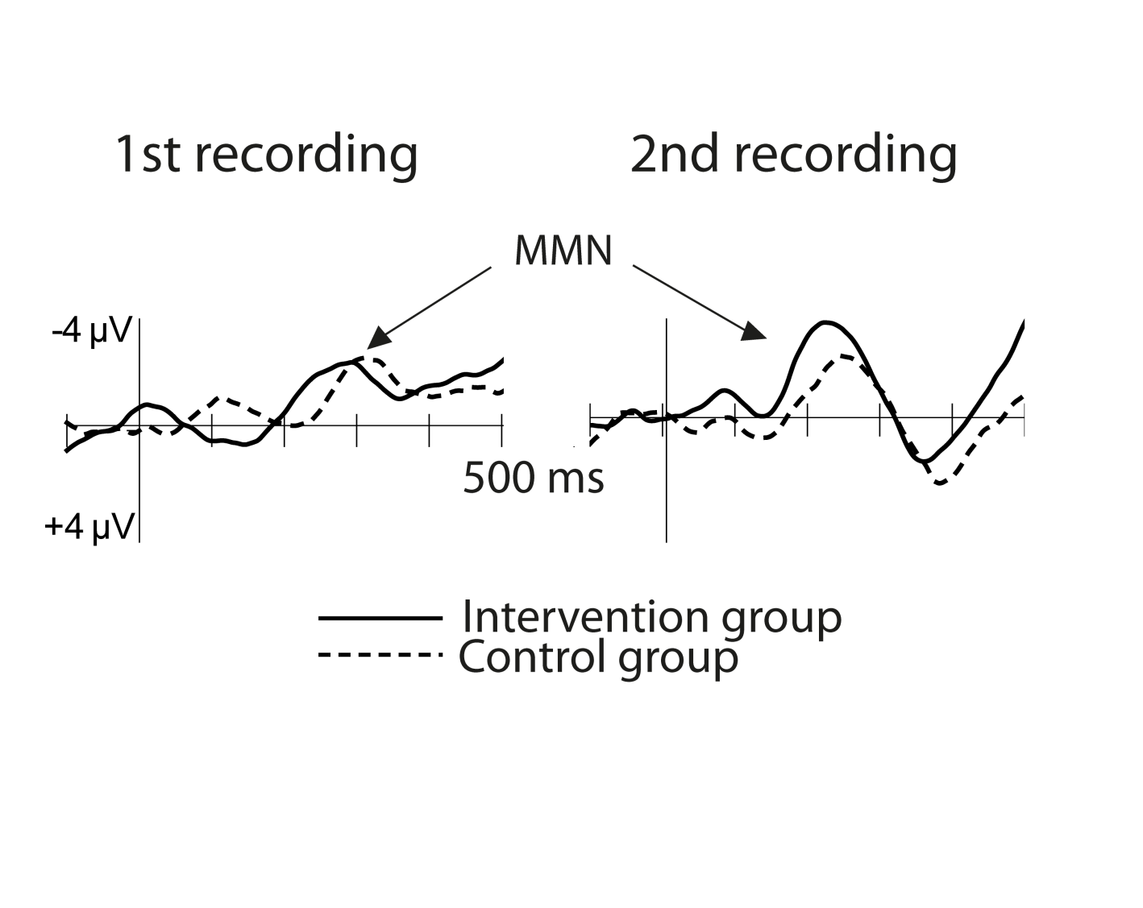
Effects of the GraphoGame training on preschoolers at risk for dyslexia - MMN before and after the intervention
Notes:
Here the MMN results support the interpretation that the effects of the training were associated with the improved phonological discrimination and thus the alleviation of the most typical bottleneck affecting reading acquisition.The training effects were best reflected in the vowel MMN. The difference curves suggest that the MMN amplitudes increased for the vowel change over time especially in the intervention group.

Slide 58
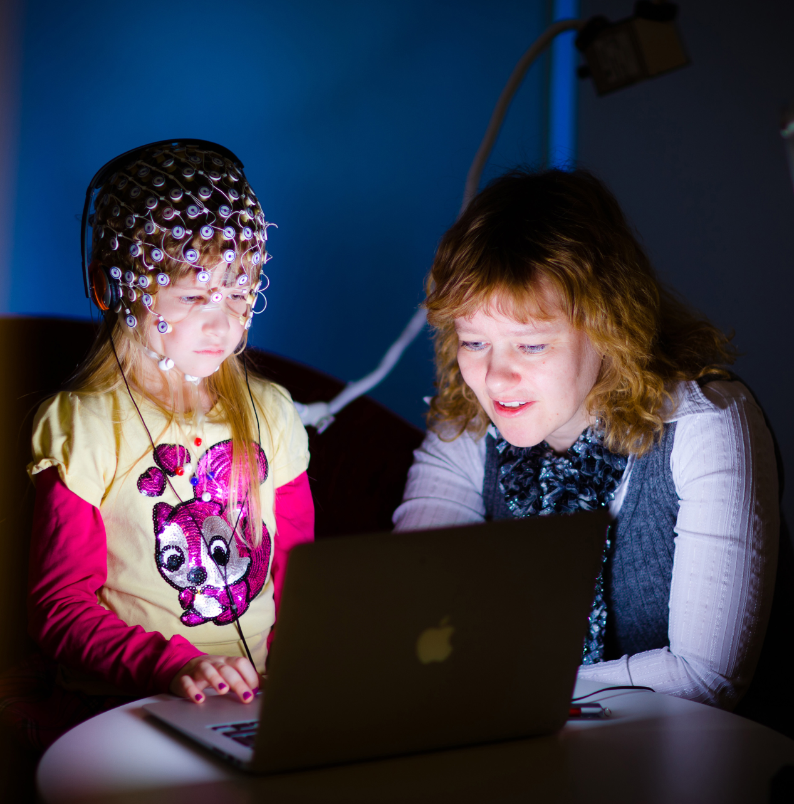
Brain ERPs observed during the use of the GraphoGame
Notes:
We can investigate what is changing using EEG method when playing GG.

Slide 59
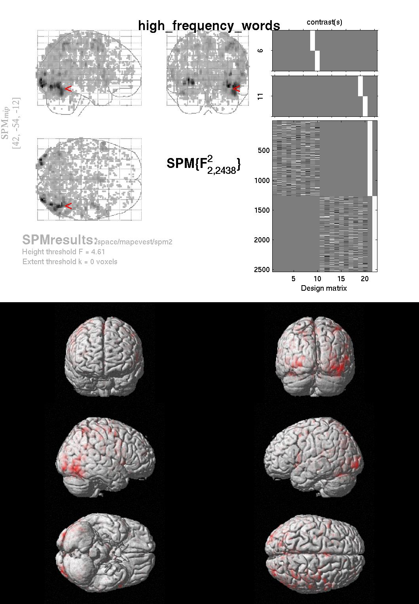
What fMRI tells about changes resulting from the use of the GraphoGame
The activation of the visual word form area (VWFA) to letter(s) emerges as the function of an increase of likelihood of the automatic elicitation of its sound in mind.
A tool to assess human learning…
Notes:
The activated brain regions may tell us what are the differences between normal and at risk children after intervention.
The differences may tell us the biological causes of dyslexia. But how about the gender differences?
Print sensitivity in the VWFS emerges rapidly during acquisition of grapheme–phoneme correspondences in young
children before full-word reading. The onset of print sensitivity of the VWFS after grapheme–phoneme training supports its central
role in initial phonological decoding as predicted by the phonological mapping hypotheses. Because phonological decoding is
a known core problem for individuals with dyslexia, a critical role of the VWFS in storing grapheme–phoneme correspondences also
could explain its reduced activity in dyslexia. Whether strengthening the VWFS sensitivity to print through grapheme–phoneme training
may alleviate potential reading problems in children with developmental dyslexia remains to be examined.
See ：Brain sensitivity to print emerges when children learn letter–speech sound correspondences for more information.
This article contains supporting information online at www.pnas.org/cgi/content/full/0904402107/DCSupplemental.

Slide 60
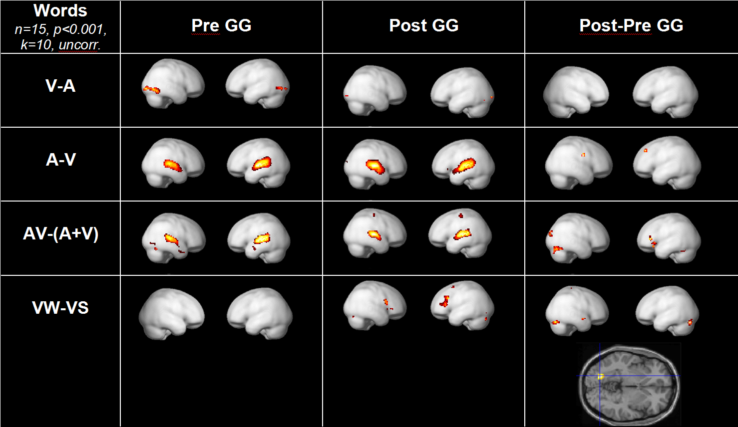
GG training of <5 hours affects brain
HL and UR in collaboration with Swiss colleagues Daniel Brandeis, Sylvia Brehm
  Pre-Post GG: Children (n=15) before and after playing with Graphogame
LG-FG, IFG
Words-False fonts
Post-pre interaction between groups playing Graphogame vs Mathgame (same with numbers): p<0.005
Brem et al., PNAS, 2010, 107(17), 7939-7944.
Notes:
Words and false fonts activated a bilateral and predominantly ventral posterior occipito-temporal network before training, as
previously found for symbol-string and object processing in both adults and children. After the brief (3–4 h)grapheme–phoneme training in linking print to speech sounds, print-sensitive activation was enhanced mainly in the posterior VWFS, with corresponding fMRI results and N1 ERP effects at around 200 ms. This finding indicates that specific brain regions in the emerging VWFS are tuned for print and adopt print-specific functions when phonological mapping of graphemes becomes feasible. The emergence of print sensitivity in cortical areas
during the acquisition of grapheme–phoneme correspondences is in line with the inverse U-shaped developmental trajectory of print sensitivity of the ERP N1, which peaks in beginning readers, i.e., a phase in which models of reading acquisition emphasize the importance of grapheme–phoneme decoding.
See ：Brain sensitivity to print emerges when children learn letter–speech sound correspondences for more information.
This article contains supporting information online at www.pnas.org/cgi/content/full/0904402107/DCSupplemental.

Slide 61
Successful preventive practice
Massed practice using the Graphogame following optimal phonics strategy helps at risk children when
* started at >6.5y of age
*played >1 x per day in subsequent days until the goal is reached
  motivated to be used in an as ”active” sounding form as possible
  motivation to continue is guaranteed by rewarding via experience of success (~80% correct trials)
  the role of parents: they show they very much like child plays GG
GraphoGame now available from www.graphogam.com
Notes:
Your project JLD has many advantages, for example , it compare normal children with at risk children to get the causes which leading to dyslexia and find the most important factor: phonetics or letter-sound. Your ERP study to newborn baby proved your hypothesis. The more important exploration is the fMRI study which investigated whether the GG prevention change children’ brain. The answer is Yes. So it is convinced that we can use GG to help children with dyslexia.

Slide 62
Challenges
Works without complications in consistent (gr>=<ph) orthographies
  Warning: may ”condition” the stimulus-response connections too deeply to allow easy relearning of different associations when there are alternative connections. 。
  Therefore, only consistent relations can be drilled without any risk of losing the necessary flexibility (alternation of associations) typical of inconsistent orthographies.
Notes:
As you described in your articles, the GG’s application encounter many challenges in inconsistent orthographies language such as English. So probably it is more difficult for English learners to remember all the “stimulus-response” connections. It may takes a lot of time to practice and remember.

Slide 63
A mimimun set of single letter-sounds selected to a version of the game – list of their sounds present in > 5% of the occurrence of the letter in English text
(Cedex databasis,among 17 million words)
An example of the statistical approach to illustrate the problems associated with consistency (or the paucity of it)
Letter % of different / all words (exemplary word)
i 62.3 24076 3471217 I (in)
19.4 4386 1083446 aI (i)
5.1 2519 283459 (social)
l 95.4 22272 2934160 l (all)
d 94.4 14990 2844232 d (and)
m 100.0 11176 1817206 m (from)
b 99.0 7726 1169525 b (be)
Computation: J.Kujala
Notes:
I think is a pretty good method to use statistic method this way to identify which target item does the child has difficulty to deal with, this seems extremely hard to know otherwise. And I think this method can provide useful information for teachers and parents to provide more specific help.
But when if come to other language like Chinese, can we apply the method same way to determine whether the child can distinguish two different words or parts of words?

Slide 64
Connection building of written and spoken units of English
Alternative approaches:
Small unit game: teaches graphemes of the most prototypical vowels, blends of CV and VC digraphs and combines into CVC words etc.
Larger unit game: phoneme approach+large rime units, blends learned small set of ph/gr in CV rime units starting from most dense neigbourhoods with consistent spelling etc.
Notes:
Both method seems fit very well in learning English, and the main focus is on phoneme of single unit.
I wonder how they have come up with this ideas.
Farther, will this kind of method have some effect on second language learner to help them change the way they read or as well as think and regard the text more like the local people?

Slide 65
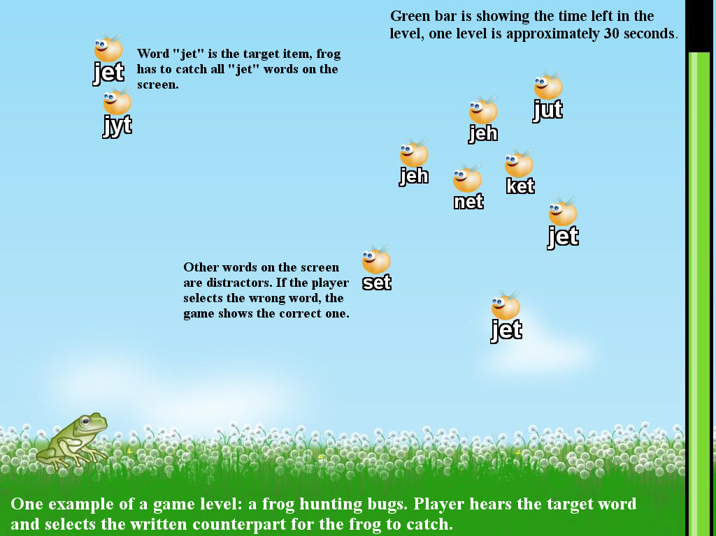
Example from the Graphogame-English
这是游戏中某一关的例子：一个青蛙正在捕捉臭虫。玩家听到目标音节的发音并且选择对应的英文
Notes:
But seems that I can do this without hearing the correct sound?
How can we make sure the child is focusing on the sound not just the letters?

Slide 66
Results of the English Graphogame
with Usha Goswami and Fiona Kyle, Cambridge Universityb
Reading gains in standard scores (SS) per hour of playing:
  Phoneme game 0.47 SS points
  Rime game 0.68 SS points
  Note: ~0.3 in the most promising earlier interventions (Hatcher et al. 2006)
  Only rime game elevated significantly the spelling skill
Kyle, Goswami et al., Reading Res. Q. 2012, 48, 61-76.
Notes:
But I think the earlier interventions just seems too useless in comparation.
This study report an empirical comparison of the effectiveness of two theoretically motivated computer-assisted reading interventions (CARI) based on the Finnish GraphoGame CARI: English GraphoGame Rime (GG Rime) and English GraphoGame Phoneme (GG Phoneme). Participants were 6–7-yearold students who had been identified by their teachers as being relatively poor at reading. The students were divided into three groups. Two of the groups played one of the games as a supplement to normal classroom literacy instruction for five sessions per week for a period of 12 weeks. The third group formed an untreated control. Both games led to gains in reading, spelling,and phonological skills in comparison with the untreated control group. The two interventions also had some differential effects. The intervention
gains were maintained at a four-month follow-up.
See ：Assessing the Effectiveness of Two Theoretically Motivated Computer-Assisted Reading Interventions in the United Kingdom: GG Rime and GG Phoneme for more information. doi:10.1002/rrq.038

Slide 67
Practical facts about the game
Available for free to all Finnish children
  Playing via net with up-to-date information for teachers and parents about learning difficulties
Very easy to use – children learn within minutes and can use without adults
  4-10 hours of preventive playing helps most at risk for dyslexia
Works also in (<100$) mobile phones
May be used for learning FL pronunciations
)
Notes:
Firstly, I’d like to say thank you for your wonderful speech in Beijing Normal University. It is amazing! I was filled with admiration that you stick to one problem for more than 20 years and apply the research result to help tens of thousands of children with dyslexia. It is my honor to have the pleasure of perusing your work: In search of a science-based application: A learning tool for reading acquisition after the lecture. I learned a lot from this article.
Finally, shall I express my respect to your huge project? It tells us how to use scientific methods to prevent at risk children with dyslexia. I hope GG could apply to Chinese children to learn Pinyin also. Thank you for your knowledge bringing to us!

Slide 68
Research Evidence of the GraphoGame and its present users and distributor
We have gained research evidence on the efficacy of GraphoGame™ training documented in tens of studies (see e.g . heikki.lyytinen.info
  using behavioral observations of learning
  observing the changes in the brain activity
At least in Finland where it is freely available to all Finns it has been in wide use during the years of the existence. Practically all children have benefited it. University of Jyväskylä and Niilo Mäki Institute had to move the distribution rights to a company (see www.graphogame.com).
It is told that millions of children are using it now.

Slide 69

GraphoGame can help all
to acquire the basic reading skills
if used as recommended
Our network is tackling global challenges compromising literacy caused by
  biological factors (dyslexia)
  insufficient teaching
  lack of social support
In Finland we have documented that it helps all independent of why child is struggling if it is used optimally – preventively, more than one short session per day starting at the time of school entry.

Slide 70
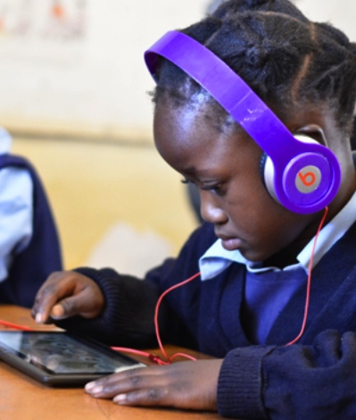
Low cost solution for developing countries
Examples
The GG works in low cost tablet and smart phone devices.
The mobile games are likely reaching the homes also in Africa within next not so many years.
。
Ministries of Education: training, learning, analytics.
For learning the results of our GG-studies in Africa, (-2015), see Ojanen et al., 2015
Notes:
The penetration rate of smart phone is high in China.There are some differences between GraphoGame's popularization in Africa and in China.I think in China,the difficulty is how to popularize the game.Because China has a totally extensive area and it's hard to popularize the game without help from the government.

Slide 71
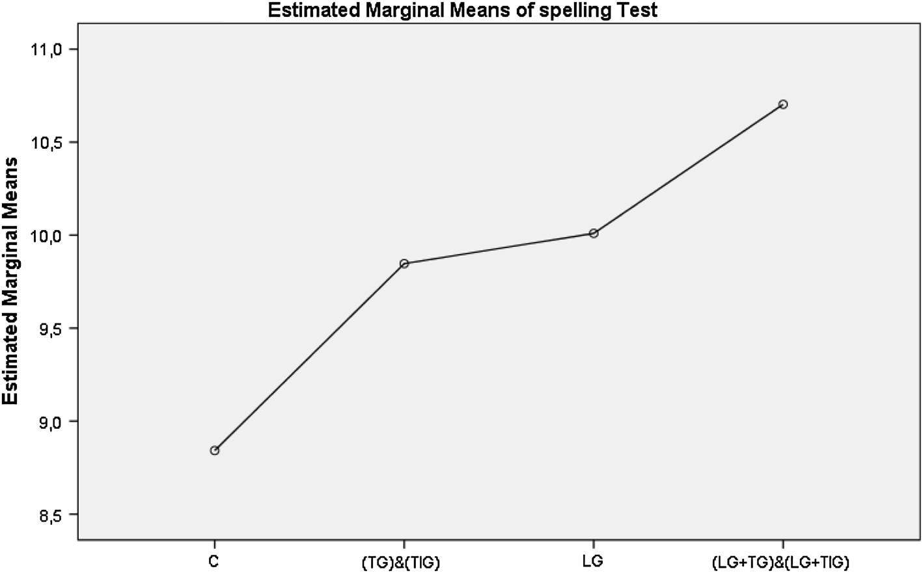
How GraphoGame helps in Zambia (Africa)
Jere-Folotiya, J., et al. (2014). The effect of using a mobile literacy game to improve literacy levels of grade one students in Zambian schools. Educational Technology Research and Development, 62 (4), 417-436.
Controls Teachers informed +children play +also teachers play
about phonics instr.

Slide 72
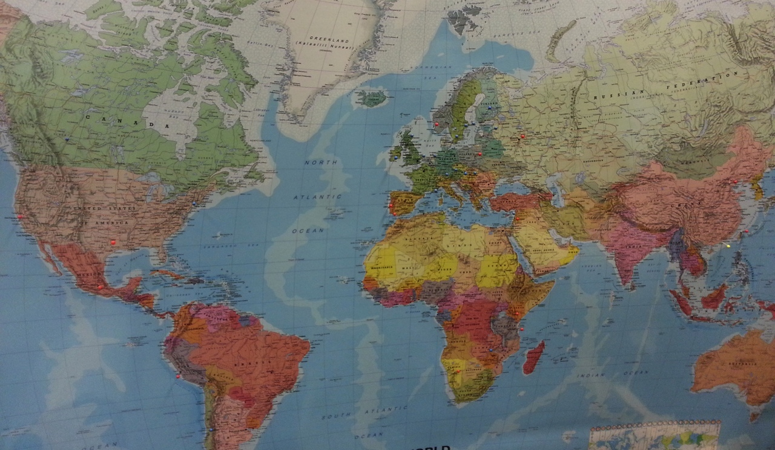
Global Network of research preparing the potential dissemination of the GG to local children in need of support
(at the time the distribution rights were sold)
Notes:
Our global network with activities in 20 countries.

Slide 73
The final step: supporting all for acquiring full literacy
To reach the main goal of reading learners need to be able to:
1. comprehend what they are able to sound out from text
2. approach text with critical attitude to consider is it true or not
3. became able to learn effectively knowledge (e.g.schoolbooks)) by reading
For children after they have acquired accurate and fluent basic reading skill we have a game to support reaching full literacy – Comprehension Game (CG)
The newest game StoryReader (SR) which is under validation, is designed to support everyone in need to take all the steps for reaching full literacy
This is needed Sub-Saharan Africa (SSA) where the necessary means are not available. After learning the basic reading skills the only natural way to start comprehending text is to have enjoyable books to which most SSA children have still today no access.
  SR will read orally exciting stories from a phone to motivate children to approach texts with the story in mind while the reading itself is expected to be acquired implicitly
  It will motivate >3- year olds to listen the most interesting contents to motivate them to follow the ”reading eyes” word by word by highligthing the to-be sounded word

Slide 74
How the support of the acquisition of full literacy is planned to be made using initially validated ComprehensionGame?
The means comprise a digital learning environment which is
  enjoyable due to working like a game
  which works in any language because it is the locals who implement the content
  for any age of learner who have the basic reading skills
  able to instruct what ever content which can be presented visually
  able to apply dynamic assessment principles and thus
    opens whatever bottleneck faced in learning by training an aspect observed to be challenging, thus realizing training and assessment concomitantly
    assessing while training by all the time openinig the still not opened bottlenecks
  able in provide immediate feedback empasizing rewarding way to go
  able to explain to learners (when needed) to help her/his to comprehend
  able to provide accurate quantification of the proceedings in learning
  able to show results of a competition (between oneself or between others)
  able to archieve the results for helping to evaluate the quality of the material
  able to document the skills of the individuals who are implementing the materials
  and thus to identify the best teachers/experts of instruction
    on the basis of how well one’s implementation of the key content has elevated children’s learning

Slide 75
The theoretical basis of the ComprehensionGame
Earlier after learning the basic reading skills children have started to read and learned to comprehend writing by reading enjoyable stories without which comprehension the stories can not be enjoyed
But today many children are no more reading as shown by PISAs
To correct the situation here are two ways to go:
1. inventing effective ways to motivate children to read (looks difficult)
to use the natural way, which was the way children learned earlier
2. To invent new way to help those who do not prefer leisure reading
The theoretial basic for an alternative way (Comprehensiongame) could start from the knowledge how human memory works
without leisure reading or guidance children tend to read all words as equal
which fails to lead to comprehension due to the memory failure
Learning (=storing to permanent memory) succeeds via working memory
Working memory (WM) has a limited capacity
One had to comprehend not only words or sentences but the whole story!
Thus the reader had to keep WM working and this requires readiness to identify the words or sentences which carry the essential meanings of the story

Slide 76
A summary of how the ComprehensionGame works
The most essential requirement is that it trains readiness to find the ESSENTIAL sentences of the story
Its realistically achievable purpose is to instruct readers to comprehend text as well as one comprehens spoken information
Availability of sufficient background information has to be guaranteed
Thus the natural context is to follow school curriculum
This requires implementing the training to daily lessons
To make it simple and easy to quantify, a solution is to motivate learners to answer sentence by sentence is each of these true or not
Thus it also trains critical reading needed in our time of false news
The game is over when all essential sentences are chosen correctly as true or not, where the not-true sentences are typical misunderstandings of learners
This way CG helps children learn 1) 100% of their daily lessons and 2) slowly start comprehending more and more efficiently the texts they read and also 3) learn to read critically

Slide 77
Thank you for your attention!
For more.., please,
call: +358 50 552 4892
have a look of our research: heikki.lyytinen.info
ask for reprint(s): heikki.j.lyytinen@jyu.fi
skim Ekapeli pages (also in English): http://www.lukimat.fi/
…and the English GraphoGame: http://www.grapholern.info
* ORDER ENGLISH GRAPHOGAME FROM WWW.GRAPHOGAME.COM from its distributors
See Comprehension Game from comprehensiongame.info
The Storyteller will open pages when it is fully validated

